Slide 1
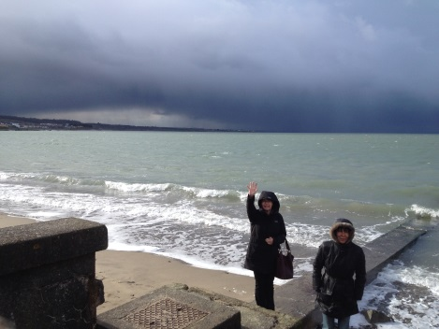
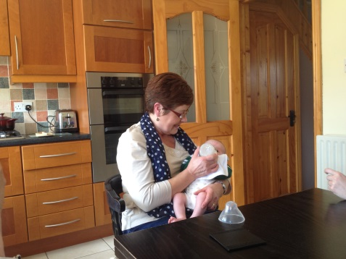
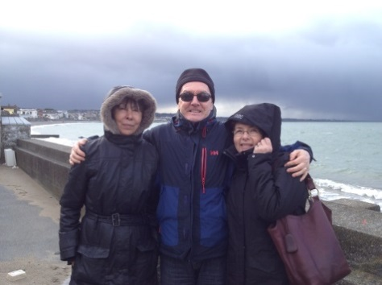
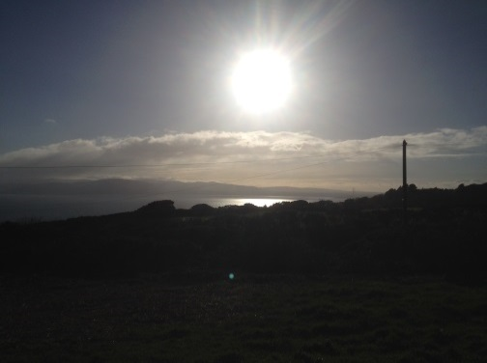
Phamily Fotos

Slide 2
Phamily Fotos
The Origin Of The Concept
People love to share their experiences online.
Images are easily (too easily) captured & uploaded.
Social Media sites exercise total control over content via their terms & conditions.
People’s sense of control over their own privacy is being lost.
People have a desire limit who can see and use their images.
Phamily Fotos plans to meet that need.

Slide 3
Phamily Fotos
Research
Privacy and the right to control over one’s own image.
This isn’t a new phenomenon and as far back as 1902 a landmark judgement was made against The Rochester Folding Box Company for having used the image of Abigail M Roberson without her permission on a pamphlet promoting Franklin Mills Flour. (Adams, et al., 2007)

